Slide 1

The Right Priority
Collection Closure
Chris Piech
CS 106B
Lecture 5
Jan 15, 2016

Slide 2

Socrative.com
Room: ACRFU4PQ3

Slide 3
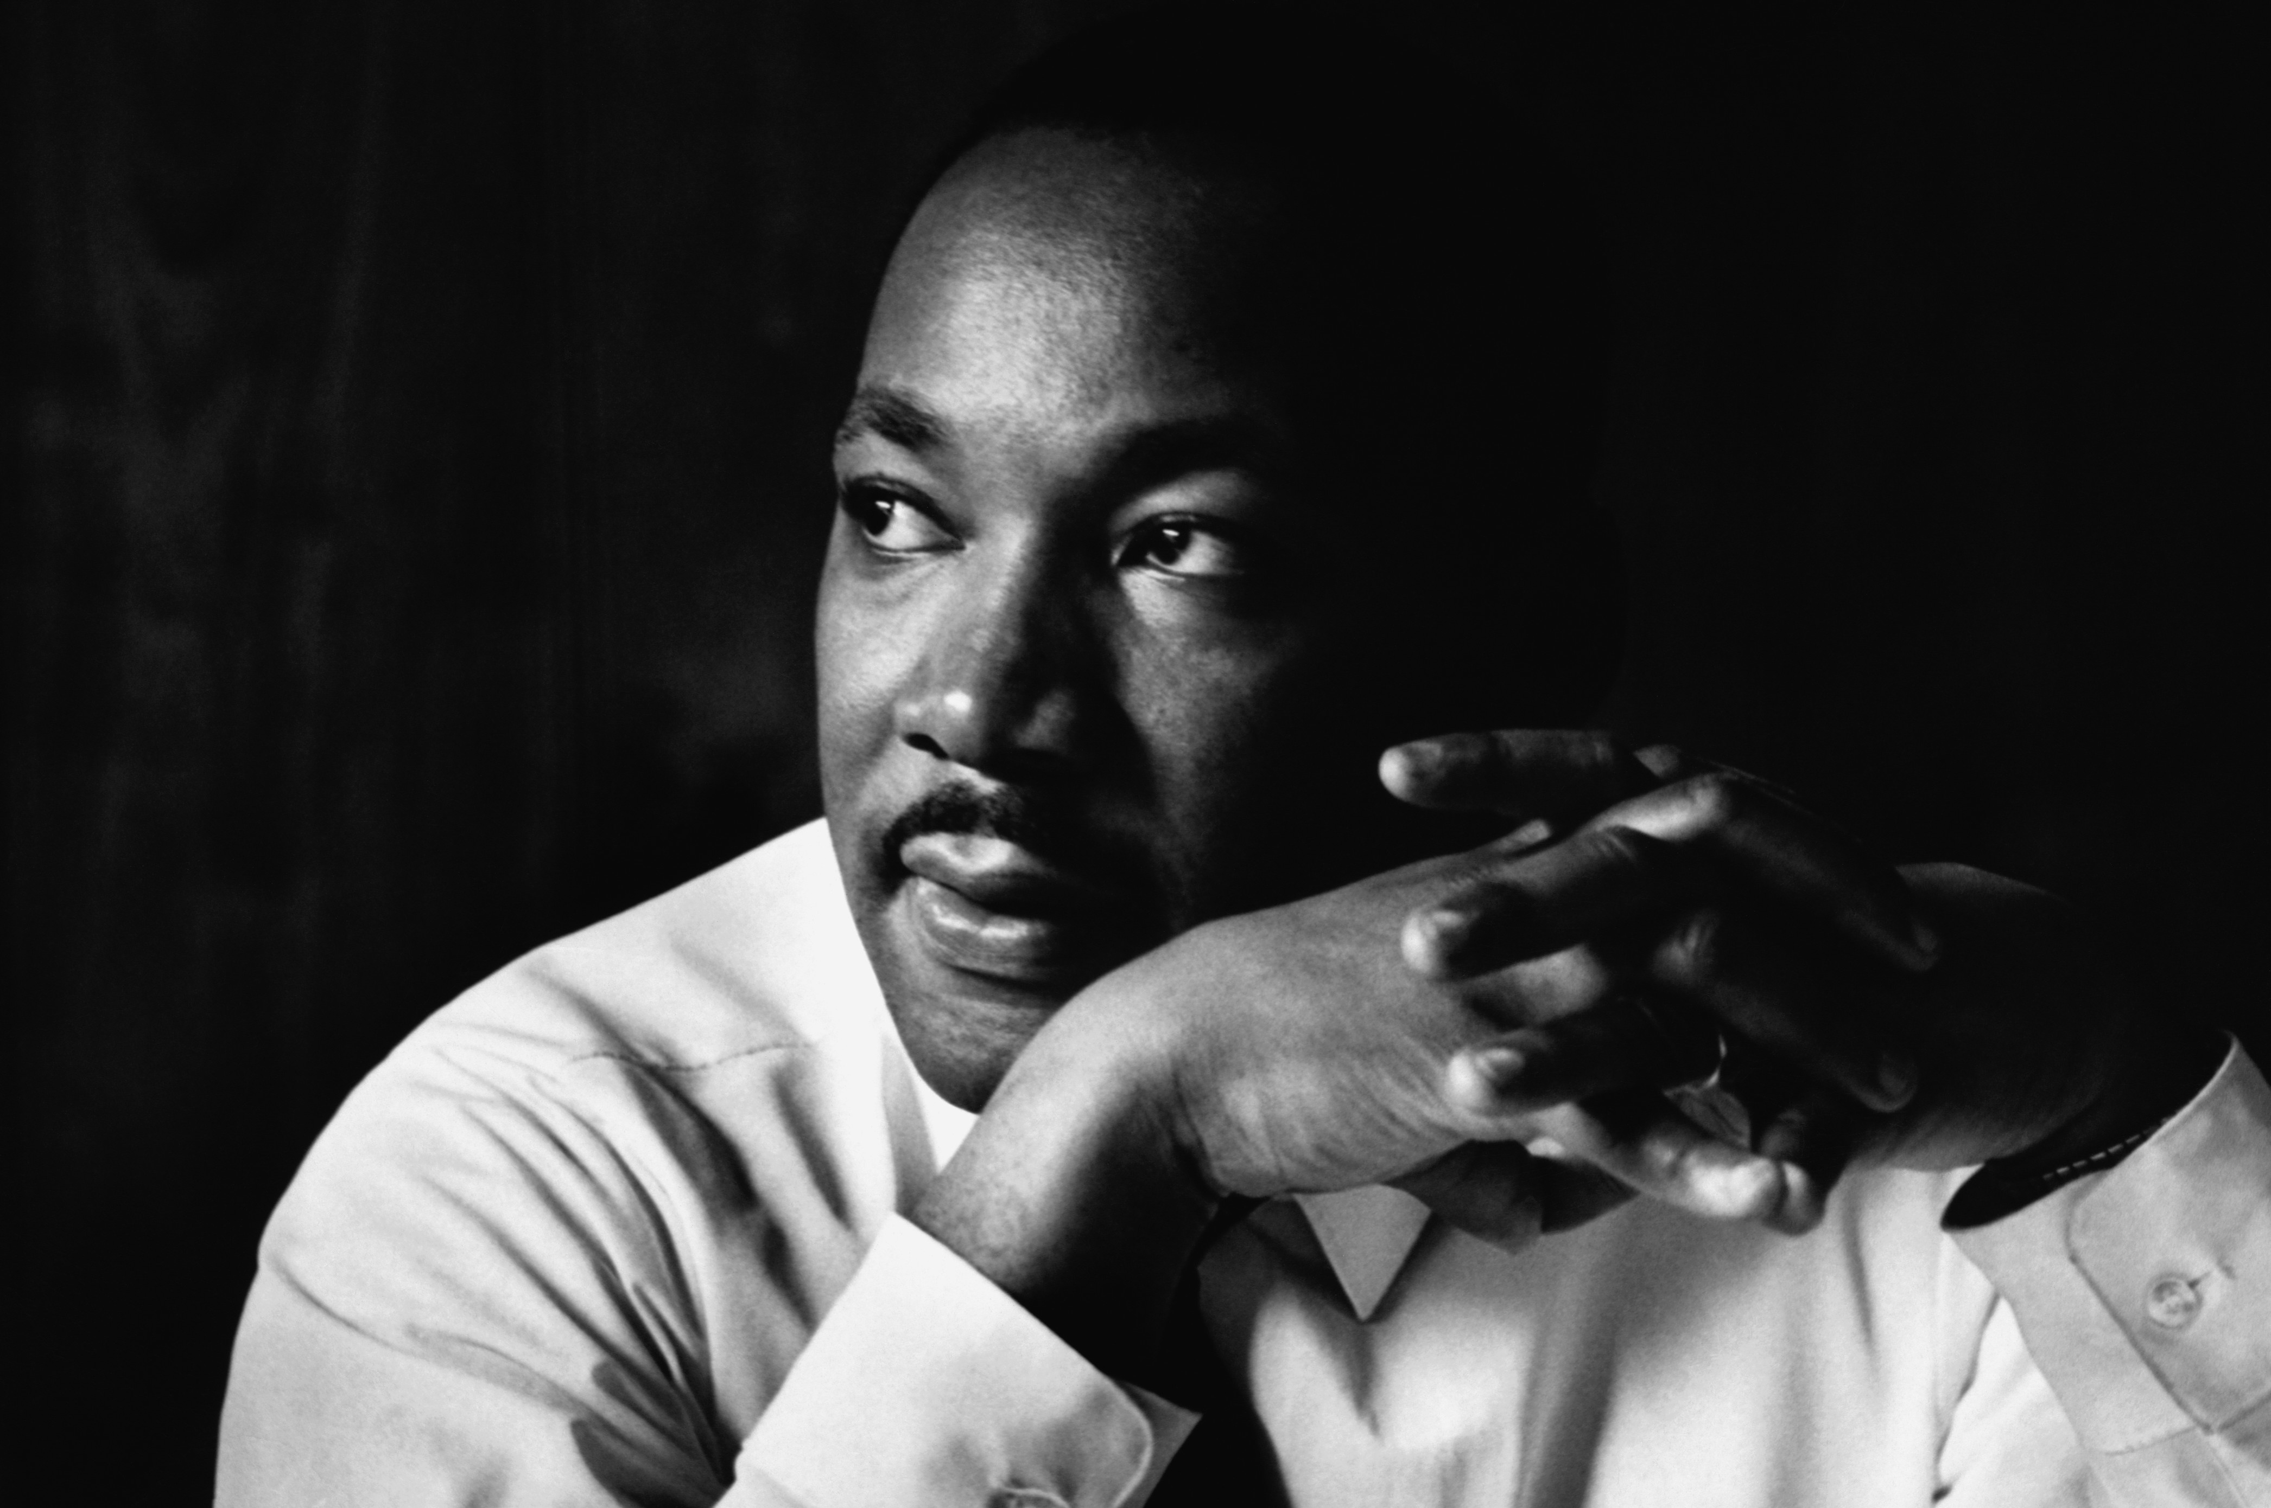
No Class Monday

Slide 4
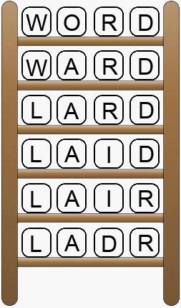
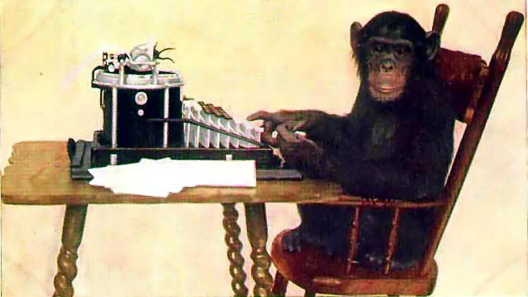
Assignment 2 Serafini
Two great ideas from Computer Science

Slide 5
Assignment 2 Serafini
Two great ideas from Computer Science
Y.E.A.H. Hours
Tue, Jan 19th 5-6pm
Braun Auditorium
Will post slides

Slide 6
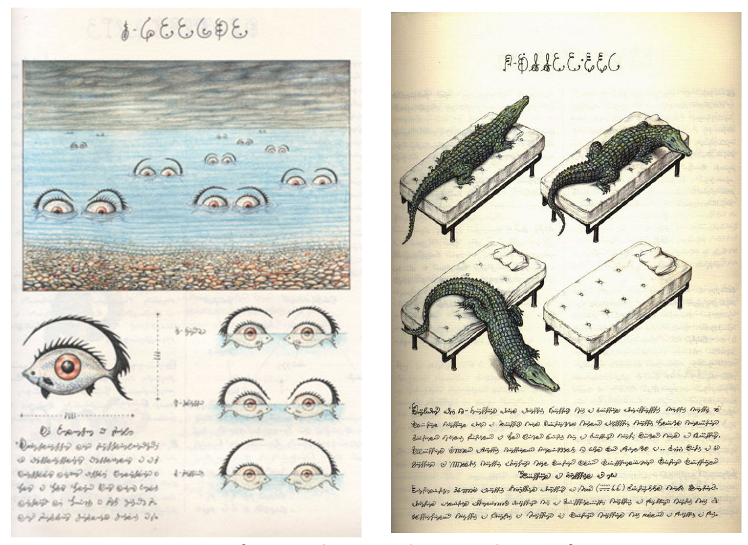
Assignment 2 Serafini

Slide 7

CS106B Contest

Slide 8
Prizes

Slide 9
[suspense]

Slide 10
100% on the Final

Slide 11

CS106B Contest
Two categories
Algorithmic Complexity
Creativity

Slide 12
CS106B Contest
Rules…
http://web.stanford.edu/class/cs106b/assn/contest.html

Slide 13
Quick Check in
What’s faster?
Check if a Vector contains a particular element
Check if a Set contains a particular element

Slide 14
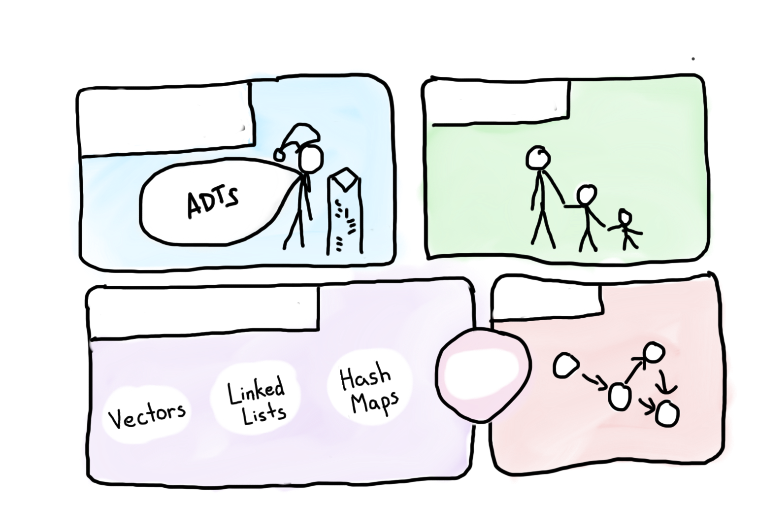

Course Syllabus
Intro to Abstractions
Recursion
Graphs
Under the Hood
Trees
You are here

Slide 15

Today’s Goals
You are ready for Assn 2

Slide 16
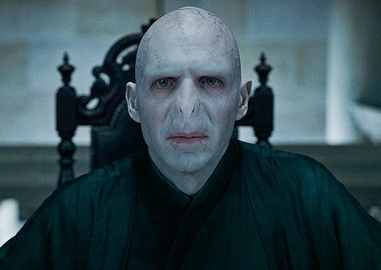
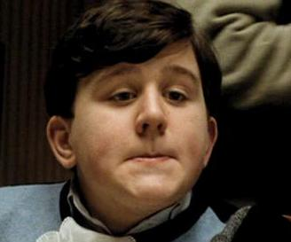

Interesting Puzzle
Counterfeiter
User
You (Distributor)

Slide 17
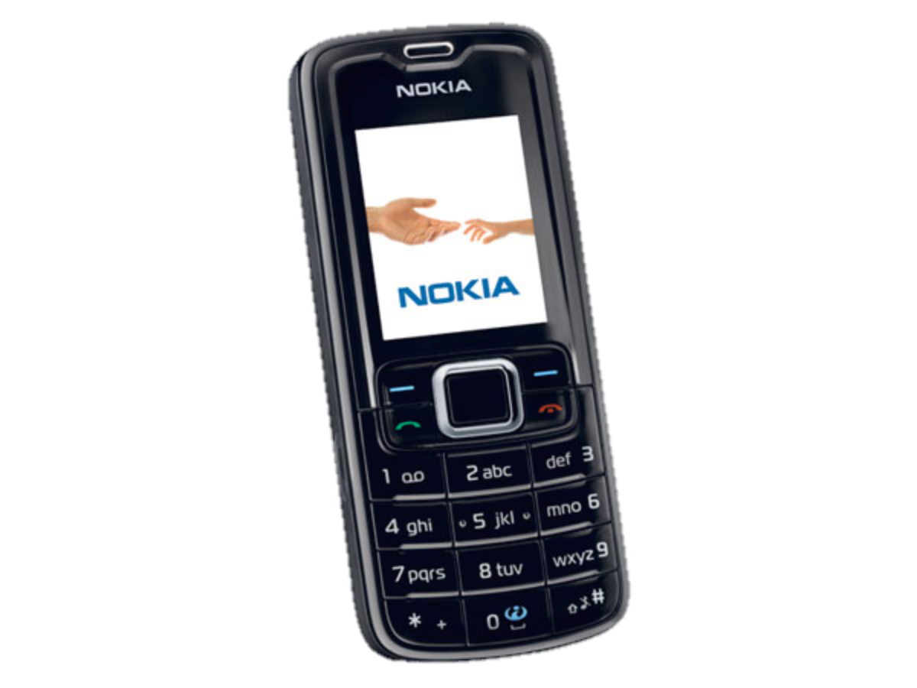
Interesting Puzzle
Counterfeiter
?
User
You (Distributor)

Slide 18

Fake Medicine is a Problem
700,000 deaths a year from fake malaria and tuberculosis drugs [1]
Equivalent of this many crashes per day
[1] http://www.un.org/africarenewal/magazine/may-2013/counterfeit-drugs-raise-africa%E2%80%99s-temperature

Slide 19
Interesting Puzzle
Counterfeiter
?
User
You (Distributor)

Slide 20
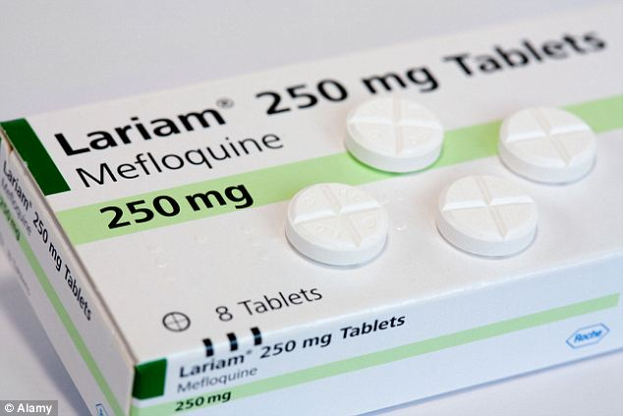
Real Life Challenge
Counterfeiter
?
User
You (Distributor)

Slide 21
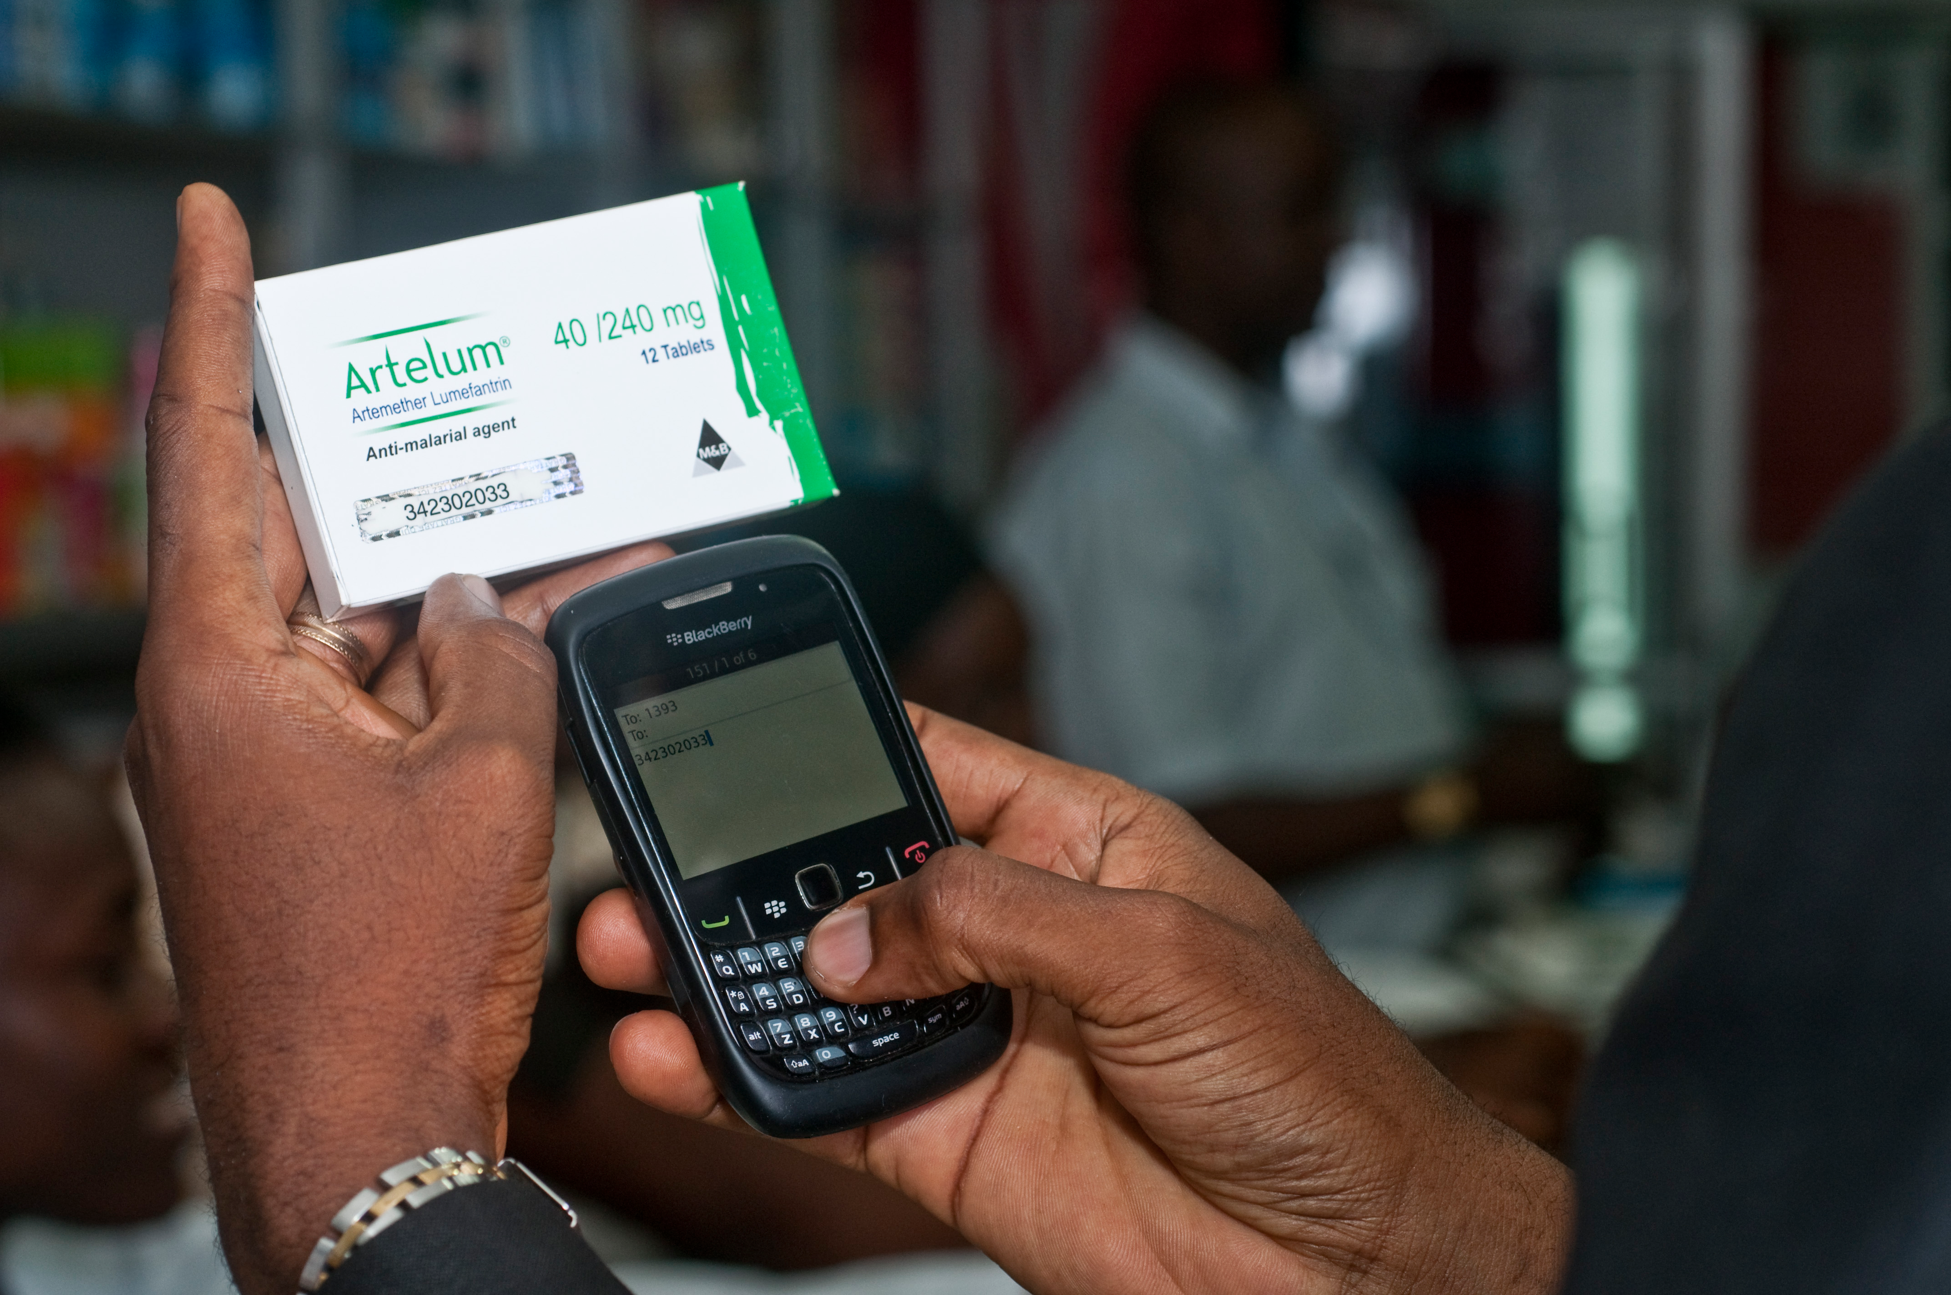

M Pedigree
Bright Simons

Slide 22
Mpedigree Datastructure (aka ADT)

Slide 23
What Datastructure
A. Vector<int>
B. Set<int>
C. Map<int, string>
D. Stack<int>

Slide 24

Solution

Slide 25
Collections
Vector
Grid
Map
Stack
Queue
Set

Slide 26

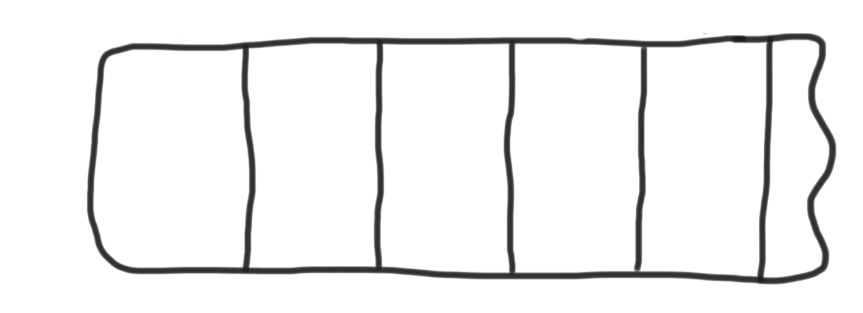
Vectors
Can grow to any size you need.
Supports random access.
0
1
2
3
4
8
15
16

Slide 27
Stack
Last in, First Out (so rude)
Slightly faster than vector.
Great style.
N
A
D
push
pop

Slide 28
Queue
First in, First Out (very fair)
Slightly faster than vector.
Great style.
N
D
A
enqueue
dequeue

Slide 29
Sets
Stores unique elements.
Put, contains and get are all incredibly fast.
No random access.
"the"
"of"
"if"
set.contains("to")
"to"
"down"
"from"
true
"by"
"she"
set.contains("be")
"you"
false
"in"
"why"
"him"
set

Slide 30
Maps
Stores key value pairs.
Put, contains and get are all incredibly fast.
Can get values using keys
"Chris"
"867-5309"
"Jenny"
"685-9138"
"Mehran"
"866-6586"

Slide 31
Lexicon
Like a set for words.
Convenient methods.
Can check if prefix exists.
”Car"
”House"
“Melifluous"

Slide 32
Collections
Vector
Grid
Map
Stack
Queue
Set

Slide 33
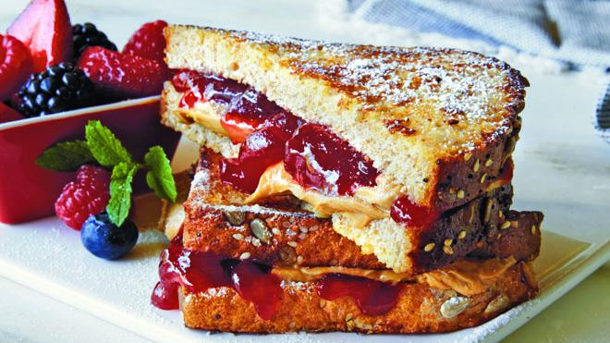
Sets, good
Maps, good
Sets + Maps, good

Slide 34
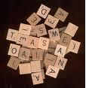
Anagram Exercise
Write a program to find all anagrams of a word the user types.
Type a word [Enter to quit]: scared
Anagrams of scared:
cadres
cedars
sacred
scared
What is the appropriate collection to use to solve this problem?
Hint: Use a compound collection...

Slide 35
Anagram Exercise
acders
{sacred, cadres,
scared, cedars}
deerssst
{stressed,
desserts}

Slide 36
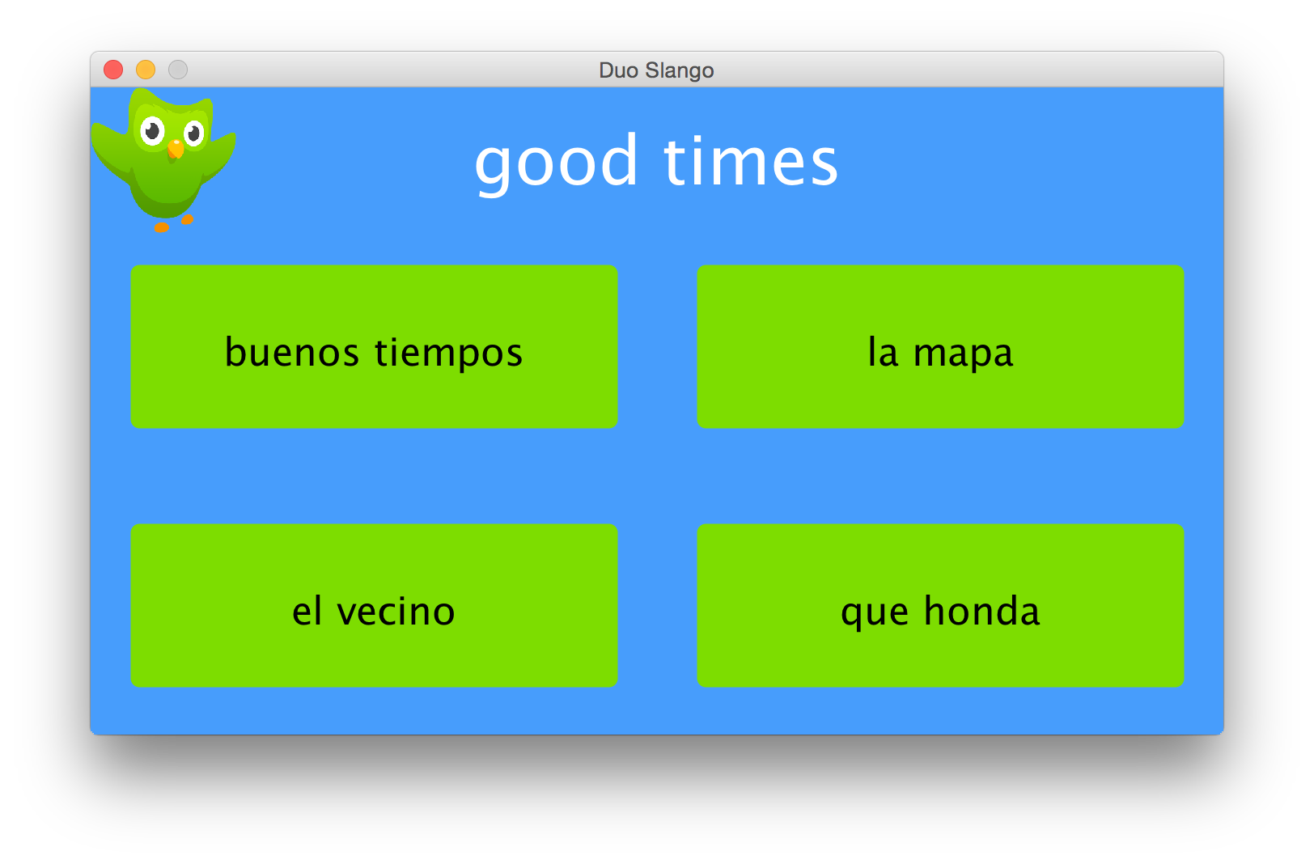
Another Cool New Program
Good, solid review and a new great idea.

Slide 37
Solution

Slide 38
In lecture I stopped here.

Slide 39
But read on for some more review…

Slide 40
Waypoints for your Spaceship?

Slide 41
Queue<Point>

Slide 42
Google Search?

Slide 43
Search term
Urls
Map<string, Set<string> >

Slide 44
Store the classes that all students in Stanford are taking?

Slide 45
student
classes
Map<string, Set<string> >
Map<string, Set<string> >
class
students

Slide 46
The Value of All Variables
in a C++ Program?

Slide 47
For each function
Variable value (a little awk)
Stack<Map<string, string>>
Variable name

Slide 48
Facebook Newsfeed?

Slide 49
PriorityQueue<string>
html

Slide 50
Today’s Goals
You are ready for Assn 2

Slide 51

A Little Bit of Slope
John Ousterhout

Slide 52

Thanks for the Time

